Slide 1

Patterns in jUnit
Design Patterns in Action

Slide 2
Course Outline
When to Improve Design – Code Smells
What is Good Design? - Principles
Elements of Good Design - Patterns
Example of Good Design - jUnit ⬅ ☺

Slide 3
Lesson, Objectives
Review the application to Patterns to an industry wide framework.
Learn how Patterns can work together to create powerful yet minimal software.

Slide 4
Overview
What is jUnit?
What jUnit Does?
A jUnit example test
Command
Composite
Template Method

Slide 5
What is jUnit?
Java implementation of the xUnit testing framework
Industry standard, open source
Focused primarily on unit testing Object Oriented programs.

Slide 6
What jUnit Does?
Runs a test suite
A Test Suite contains a number of test cases
Each test case has test methods
Each test method is run independently in isolation
Test cases can define set up and tear down actions for each of the test methods they contain
Reports the test results in terms of:
  Runs
  Failures: an assertion failed.
    Example: assertEquals(3 , 1+1);
  Errors: something outside of the expected test results occurred.
    Example: an unexpected null pointer exception occurred.

Slide 7
jUnit Example
Calendar eCal = new Calendar();
public void testSameGroup() {
eCal.createEvent("xpCinci", "programming", new Date(103, 0, 12));
eCal.createEvent("cinjug", "programming", new Date());
assertEquals(2, eCal.countOfEvents());
assertEquals(1, eCal.countOfGroups());
}
public void testDiffGroup() {
eCal.createEvent("xpCinci", "programming", new Date(103, 0, 12));
eCal.createEvent("hornTrio", "music", new Date());
assertEquals(2, eCal.countOfEvents());
assertEquals(2, eCal.countOfGroups());
}

Slide 8
jUnit self-tests
Goto the directory: examples/src
C:/patterns/examples/src> java junit.samples.AllTests
.........................................
.........................................
......................................
Time: 1.822
OK (119 tests)

Slide 9
jUnit Goals
to write a framework so that developers will actually write tests.
  Based on familiar tools.
  Minimal amount of work to use to write a new test.
  It has to eliminate duplicated effort.
Tests retain value over time
  Others can run and interpret the results.
  Combine tests from various authors and run them together.
Leverage existing tests to create new ones
  Fixtures can be difficult and expensive
  Setup of Fixtures should be shared among tests.

Slide 10
Testing … testing
Tests can come in many forms and formats
  Shell scripts
  Print statement embedded in the code surrounded with a macro or if() statements
  Debugger expressions
We would like a representation that is easy to compose, construct and manipulate.
How about an Object?
Ok, what kind???

Slide 11
Pattern: Command
Making a test into an Object
“Encapsulate a request as an object, thereby letting you… queue or log requests…“
… or test !
Instead of execute() jUnit uses run()

Slide 12

TestCase as a Command
public abstract class TestCase implements Test {
private final String fName;
public TestCase(String name) {
fName= name;
}
public abstract void run();
…
}

Slide 13
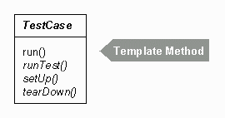
What does run() do?
Every test does three things
  Sets up the initial environment for the test.
  Runs the test.
  Tears down or cleans-up the environment leaving everything ready for the next test.
What exactly setUp(), run(), and tearDown() do should be left to individual test case classes.
This is an example of the Template Method Pattern

Slide 14
Pattern: Template Method
Define the policy in the template method and let the particulars be implemented by subclasses.
AbstractClass
public void templateMethod( ) {
primitiveOperation1( );
primitiveOperation2( );
}
templateMethod( )
primitiveOperation1( )
primitiveOperation2( )
ConcreateClass
primitiveOperation1( )
primitiveOperation2( )

Slide 15
Template Method Consequences
Template Methods are a central technique for code reuse.
They are often used in class libraries.
Provide an inverted control (and dependency) structure sometimes called the “Hollywood Principle”
  Don’t call us, we’ll call you
Template Methods call on of the following kinds of methods:
  Concrete methods on the Concrete class.
  Concrete methods on the AbstractClass (for code sharing purposes).
  Primitive operations.
  Factory Methods.
  Hook methods that provide default behavior and allow for extension.
The Template Method should state which methods are Hook methods and can be overridden.

Slide 16
Reporting Results - TestResult
If a test case runs in the forest, does anyone care about the results?
Could put a counter on the TestCase
  But since it mostly succeeds this would be unnecessary clutter
Need to collect the special results across all the executed tests.
Maybe just maybe this is the job of another object?
How about the Collecting Parameter Pattern.

Slide 17
Pattern: Collecting Parameter (Ref 1)
When you need to collect results over several methods
add a parameter to the method
pass an object that will collect the results for you
public class TestResult extends Object {
protected int fRunTests;
public TestResult() {
fRunTests= 0;
}
}

Slide 18
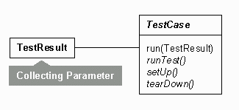
Simplified run() with results
public void run(TestResult result) {
result.startTest(this);
setUp();
runTest();
tearDown();
}
public class TestResult extends Object {
protected Vector fFailures;
protected Vector fErrors;
protected int fRunTests;
// …

Slide 19
Collecting Parameter’s distant cousin
Collecting parameter can be passed as a parameter among methods within the same object to gather information.
Or it can be passed among the same method in different objects.
What other Pattern does this remind you of?

Slide 20
Whose running things here?
When the TestCase run(TestResults tr) method is called, it could capture the results and then add them to TestResult.
TestCase would have to determine if the test was success or failure.
TestCase would have to catch Exceptions and provide them to TestResult.
Does that Smell like anything?
TestCase would have TestResult Feature Envy.
Instead, TestCase asks TestResult to:
  Class TestCase ...
  public void run(TestResult result) {
  result.run(this);
  }
This reversal allows TestResult to collect results without involving any other objects.

Slide 21
Multiple Tests
The invoker of the tests should not care if there is one test or many. It just wants to run the tests.
Which Pattern should we consider?
Composite Pattern.

Slide 22
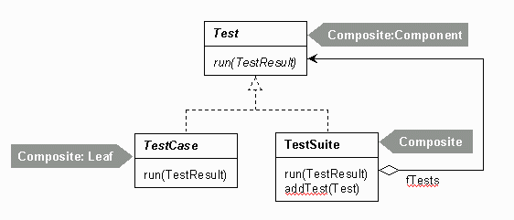
TestSuite: Composite
Composite introduces the following participants:
  Component: declares the interface to use to interact with tests.
  Composite: implements this interface and maintains a collection of tests.
  Leaf: represents a test case in a composition that conforms to the Component interface.
public interface Test {
public abstract void run(TestResult result);
}

Slide 23
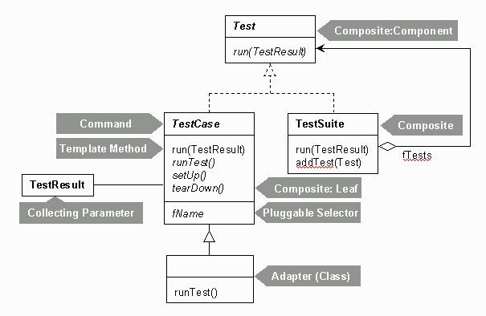
jUnit Patterns so far…

Slide 24
Reporting the results
Java 1.0 used awt for GUI building.
Automatic tools like ant use command line directives.
Java 1.2 introduced the swing GUI.
Eclipse uses the SWT.
Anything else?
For jUnit to be universal it should loosely coupled with the UI.
Any thoughts on how to do this?

Slide 25
Pattern: Observer (Listener)
Define a one-to-many dependency between objects so that when on object changes state, all its dependents are notified and updated automatically.
In this case we don’t need ‘one-to-many’.

Slide 26
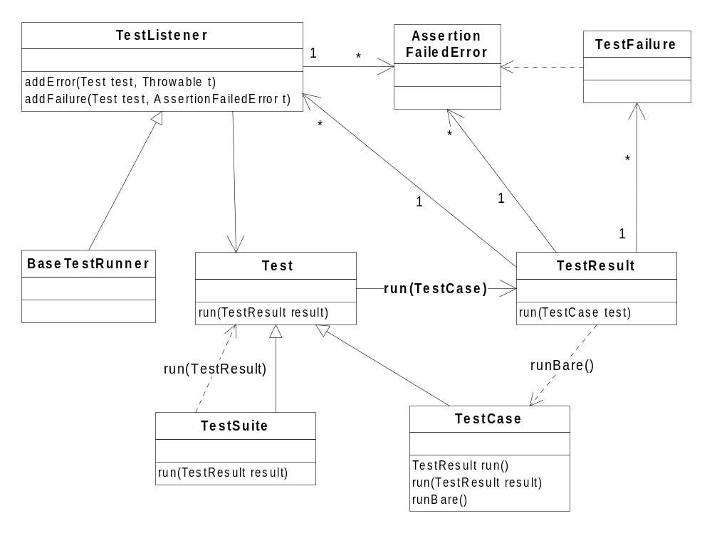
TestListener
Observer
Concrete
Observer
Subject

Slide 27
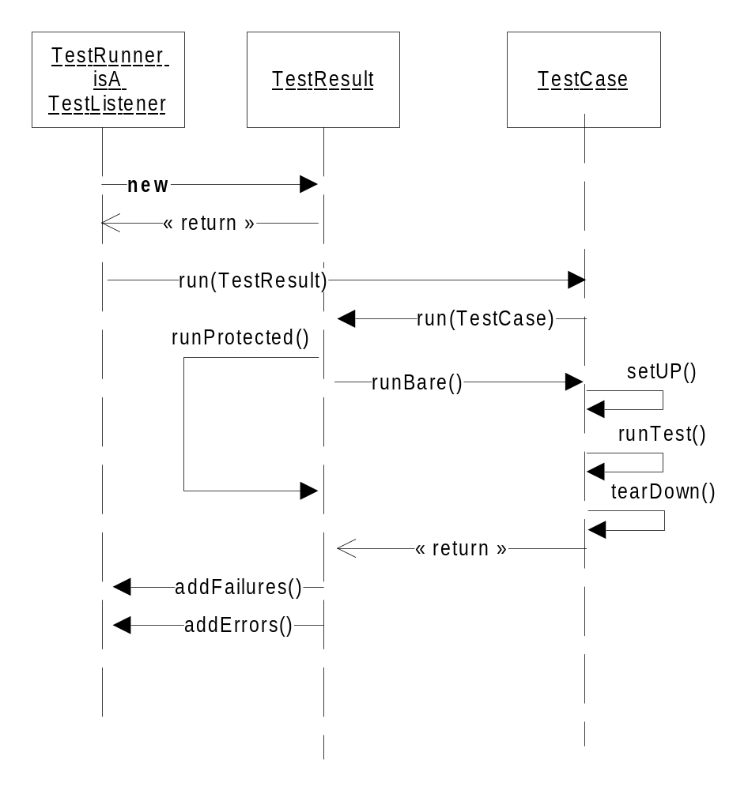
Sequence Diagram
Note:
textui.ResultPrinter isA TestListener

Slide 28
Exercise
In test-first programming we strive to work on only one test at a time. Sometimes, however, we break a handful of unrelated tests, while focusing on our new test.
Therefore, want to temporarily Idle a test method.
We do this so that we can work on fixing one test at a time, but we don’t want to check in the code unless all the tests are running again.
Any method name starting with: “idletest…” is Idle
The TextRunner should print an “I” and not run a test that has been marked as Idle.

Slide 29
Expected output from textui.TestRunner
C:/patterns/examples/src> java junit.samples.AllTests
.I........................................
.........................................
......................................
Time: 1.822
OK (120 tests)

Slide 30
Exercise Answer
Add a test method into samples.VectorTest
  public void idletestExtraTest(){ fail(); }
The following classes could be involved in a solution (maybe)
  Junit.textui.ResultPrinter
    addIdle() and print “I”
  Junit.framework.TestListener
    addIdle()
  junit.framework.IdleTestError
    something to throw
  junit.framework.TestCase
    throw in runTest()
  junit.framework.TestResult
    Vector fIdle, addIdle(), catch in runProtected()
  junit.framework.TestSuite
    isIdleTestMethod()

Slide 31
References
Design Patterns
  Elements of Reusable Object-Oriented Software
    By Gamma, Helm, Johnson, & Vlissides
Smalltalk Best Practice Patterns
    By Beck, K., Prentice Hall, 1996

Slide 32
Topics in OO Development
Lean Software
Development
Principles
Design Patterns
Domain Design
Analysis Patterns
Practices
Unit Testing
Architecture
Patterns
Fitness Testing

